Slide 2
Lesson 2: Object Oriented Analysis (10hrs)
Representation of System Behavior
System Sequence Diagram
System sequence diagram and use case
Building Conceptual/object Model
Identifying object
Adding Associations
Adding attributes

Slide 3
Representation of System Behavior
UML
Structural
Diagram
Behavioral
Diagram
Class
Diagram
Use Case
Diagram
Object
Diagram
Sequence
Diagram
Component
Diagram
Collaboration
Diagram
Deployment
Diagram
State Chart
Diagram
Activity
Diagram

Slide 4
System Behavior
System behavior describes what a system does.
It hides the implementational details of how the system performs.
It provides the dynamic model of the system.
It must show the reaction of system with external events, timer events, and faults with a time frame embedded within it.
System behavior can be represented by:
Use Case
System Sequence Diagram (SSD)
Operation Contracts

Slide 5
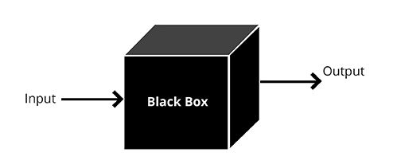
System Behavior
A system behavior is depicted as a black box.
A "black box" refers to a device, system, or process whose internal workings are not transparent or visible to the observer.
The term is used metaphorically to describe a situation where the inner workings are not understood or are intentionally hidden from view.
When something is treated as a black box, the focus is on its inputs, outputs, and the relationship between them, without detailed knowledge of the internal mechanisms.

Slide 6
System Behavior
Key characteristics of a black box:
Inputs:
External stimuli or information that is provided to the black box.
Processing:
Internal operations or mechanisms that transform inputs into outputs.
Outputs:
Results, responses, or actions produced by the black box.
Transparency:
Lack of visibility into the internal workings of the system.

Slide 7
System Behavior
The emphasis is on understanding how the system responds to stimuli and produces results without needing to know the internal processes.
This abstraction is particularly useful during the early stages of system analysis and design, providing a high-level view of the system's interactions with its environment.

Slide 8
Key Characteristics of Describing System Behavior as a Black Box
Inputs:
Definition:
External stimuli or data provided to the system.
Focus:
What information or events trigger the system to perform certain actions.

Slide 9
Key Characteristics of Describing System Behavior as a Black Box
Processing:
Definition:
The system's internal operations or logic.
Black Box Perspective:
This aspect is not explored or detailed; it is treated as an opaque process.

Slide 10
Key Characteristics of Describing System Behavior as a Black Box
Outputs:
Definition:
Results, responses, or actions generated by the system.
Focus:
Understanding the outcomes produced by the system.

Slide 11
Key Characteristics of Describing System Behavior as a Black Box
Transparency:
Definition:
Exchanges of information or events between the system and its environment.
Black Box Perspective:
Describing the nature and format of interactions without revealing the internal workings.

Slide 12
System Behavior
An interesting and useful question in software design is this:
What events are coming into our system? Why? Because we must design the software to handle these events (from the mouse, keyboard, another system,) and execute a response.
Basically, a software system reacts to three things:
external event from actors (humans or computers),
timer events, and
faults or exceptions (which are often from external sources).
Therefore, it is useful to know what, precisely, the external input events of the systems are. They are an important part of analyzing system behavior.

Slide 13
System Behavior
Use cases describe how external actors interact with the software system.
During this interaction, an actor generates events to a system, usually requesting some operation in response.
For example, when a cashier enters an item's ID, the cashier is requesting the POS system to record that item's sale.
That request event initiates an operation upon the system.
It is desirable to isolate and illustrate the operations that an external actor requests of a system, because they are an important part of understanding system behavior.

Slide 14
System Sequence Diagram
SSD represents the system behavior
It shows what the system does without explaining how
Shows events within the use case
Drawn in respect with the use case diagram drawn
Each actor has a specific SSD
Whereas rest of the UCD is seen as black box
It shows system, interacting actors, system events, response operation

Slide 15
System Sequence Diagram
An SSD shows, for a particular course of events within a use case,
the external actors that interact directly with the system,
the system (as a black box), and
the system events that the actors generate (see Figure).
Time proceeds downward, and the ordering of events should follow their order in the scenario.

Slide 16
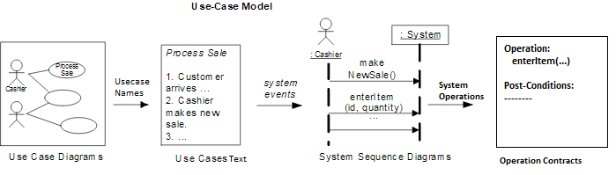
System Sequence Diagram

Slide 17
UCD to SSD
For a use case scenario, an SSD shows:
The System (as a black box)
The external actors that interact with the System
The System events that the actors generate
SSD shows operations of the System in response to events, in temporal order
Develop SSDs for the main success scenario of a selected use case, then frequent and salient alternative scenarios

Slide 18
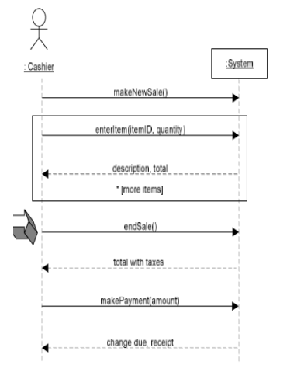
UCD to SSD
Draw the system as a black box on the right side
For each actor that directly operates on the System, draw a figure and a lifeline on the left side
For each System event that each actor generates in a use case, draw a message
Optionally, include use case text to the left of the diagram

Slide 19
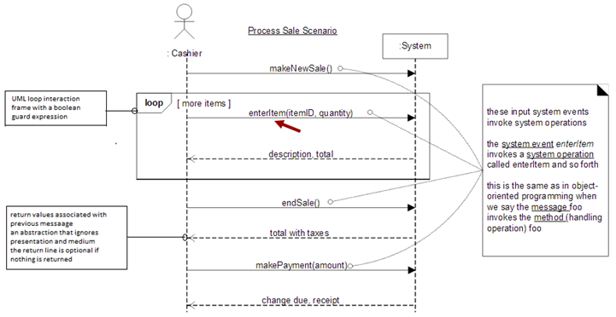
UCD to SSD

Slide 20
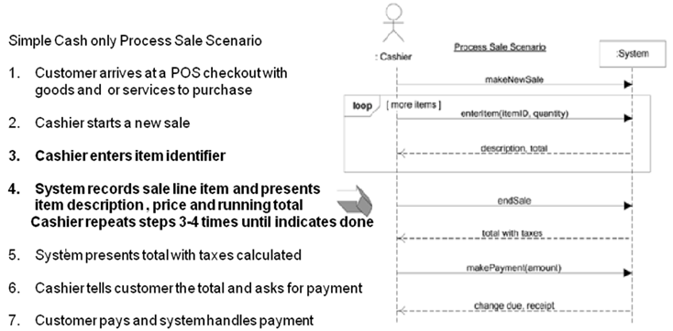
UCD to SSD

Slide 21
Components in SSD
External Actors:
Definition: Entities outside the system boundary that interact with the system.
Representation: Typically represented as labeled stick figures or other symbols.
Role in SSD: External actors initiate the sequence of messages by sending requests to the system.

Slide 22
Components in SSD
System:
Definition: The main entity or component representing the entire system that processes the requests from external actors.
Representation: Often represented as a box or a labeled component.
Role in SSD: The system receives messages from external actors, processes them, and sends responses.

Slide 23
Components in SSD
Lifelines:
Definition: Vertical dashed lines representing the existence of entities (external actors or the system) over time.
Representation: Each participant (external actor or the system) has a separate lifeline shown from top to bottom.
Role in SSD: Lifelines show the entities involved and their interactions over the sequence of messages.

Slide 24
Components in SSD
Messages:
Definition: Arrows representing the flow of communication between lifelines.
Representation: Labeled arrows indicating the direction of message flow and the content of the message.
Role in SSD: Messages represent the interactions between external actors and the system, specifying requests and responses.

Slide 25
Components in SSD
Messages types:
1. Asynchronous messages
It is a message where the sender is not blocked and can continue executing.
Representing by solid line with open arrowhead.

Slide 26
Components in SSD
Messages types:
2. Synchronous messages
It is a message where the sender is blocked and waits until the receiver has finished processing of message.
It is invoked when the caller waits for the receiver to return from the message invocation.
It is represented by solid line with filled arrowhead.

Slide 27
Components in SSD
Messages types:
3. Reflexive messages/self message
If the actor or system sends the message to itself then it is called as ‘Reflexive message’.
It is represented by solid line with loops the lifeline of actor.

Slide 28
Components in SSD
Messages types: Request vs Response
Solid Arrow: Represents a request message from the actor to the system.
For example, "Place Order" and "Validate Order" are requests from the customer to the online shopping system and from the online shopping system to the inventory system, respectively.
Dashed Arrow: Represents a response message from the system back to the actor.
For example, "Confirm Order," "Send Confirmation," and "Notify Order" are responses from the online shopping system and the inventory system back to the customer and the online shopping system, respectively.

Slide 29
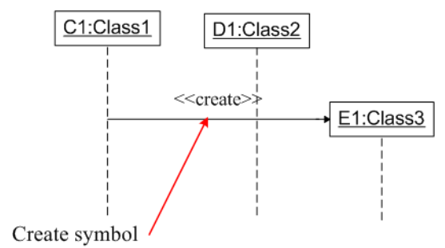
Components in SSD
Messages types:
4. Create messages
It is used to create actors during interaction.
The actors can be created by using <<create>> to indicate the timing of creation.
Creating message can be shown as below:

Slide 30
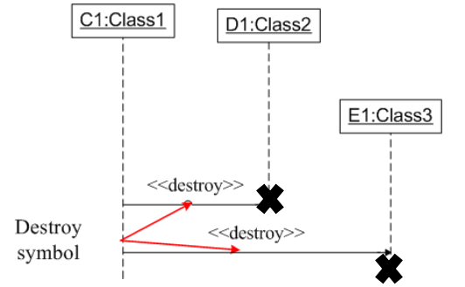
Components in SSD
Messages types:
5. Destroy messages
It is used to destroy the actors during interaction.
The actors can be terminated using <<destroy>> which points to an “x”.
It indicates that actor named message is terminated.
Note: Avoid modeling actor destruction unless memory management is critical.

Slide 31
Components in SSD
Activation Bars (Optional):
Definition: Horizontal lines on a lifeline indicating the duration during which an entity is active or processing a message.
Representation: Thin rectangles spanning the duration of a message interaction.
The top of rectangle is aligned with start of the action.
The bottom is aligned with its completion and can be marked by a written message
Role in SSD: Activation bars provide a visual representation of when an entity is actively processing a message.

Slide 32
Components in SSD
Conditions (Optional):
Definition: Additional information associated with a message, such as conditions or data.
Representation: Text annotations attached to messages.
Role in SSD: Conditions provide details about the circumstances or data associated with a particular message.

Slide 33
Components in SSD
Conditions (Optional):
syntax: [expression or condition] message-label
The message is sent only if the condition is true
[ user valid= “true”] give access
Iteration (Optional)
syntax: * [expression or condition] message-label or *message-label
The message is sent many times to possibly multiple receiver objects
*draw(), here draw function is called iteratively

Slide 34
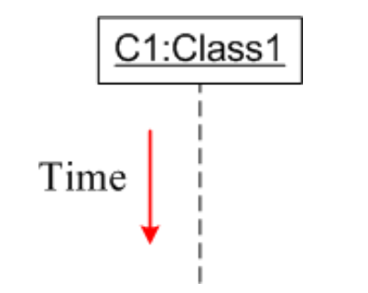
Components in SSD
Time
Time is all about ordering but not duration.
So, time is an important factor.
The time on the sequence diagram starts at the top of the page just below the object and then progresses down the page.
The sequence diagram describes the order in which interaction takes place.

Slide 35
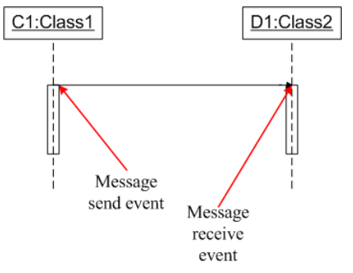
Components in SSD
Event:
Event is created while sending and receiving messages.
When interaction takes place, Events are called as build in blocks for messages and signals.
It can be referred as the smallest part of an interaction and event can occur of at any given point in a Time

Slide 36
How to make a Sequence Diagram
Draw a line representing the system as a Black Box
Identify each actor that directly operates on the system. Draw a line for each such actor
From the Use Case typical course of events text, identify the system (external) events that each actor generates. Illustrate them on the diagram.
Optionally, include the use case text to the left of the diagram.

Slide 37
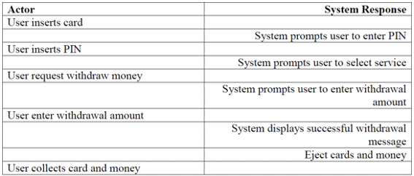
Practical

Slide 38
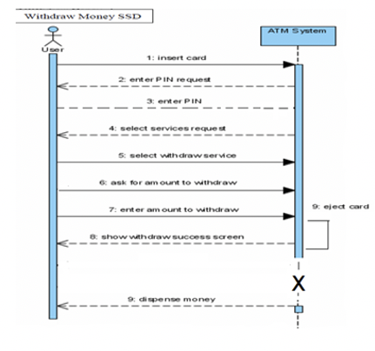
Practical

Slide 39
Practical Money Withdrawal from ATM
Customer ATM Bank Account
Withdraw Money -----> Request Withdrawal -----> Verify Withdrawal Limits
Receive Cash <------ Dispense Cash <------ Update Account Balance
Confirm Withdrawal <---- Return Receipt <---- Notify Transaction

Slide 40
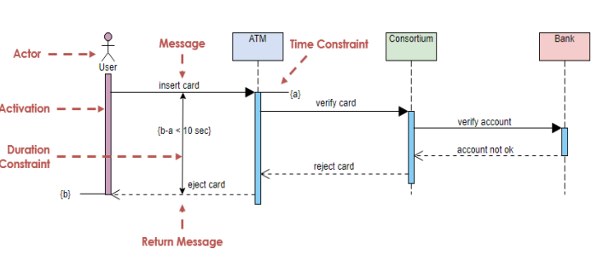
Practical Card Rejection from ATM

Slide 41
System on Contract
SOC models the system behavior using the contracts.
The contracts are pre-condition and post-condition.
The contracts are created for any system event.
Let us look at a system event called “make new sale”.
The precondition are availability of items, reading barcode, etc.
The post condition are bill generation, inventory update, etc.
These contracts are very important to carry out any changes.

Slide 42
System on Contract
Use cases are the primary mechanism in the UP to describe system behavior and are usually sufficient. However, sometimes a more detailed description of system behavior has value.
Contracts describe detailed system behavior in terms of state changes to objects in the Domain Model, after a system operation has executed.
It is a document that describes what an operation commits to achieve.
It is usually declarative in style, emphasizing what will happen rather than how it will be achieved.
It is common for Contracts to be expressed in Terms of Pre and the Post Conditions state changes

Slide 43
System on Contract
It gives detailed representation of system behavior.
Contract describes outcome of executing system operation in terms of state changes to domain objects.
It is a document containing:
Operation
Cross Reference
Pre-conditions
Post-conditions

Slide 44
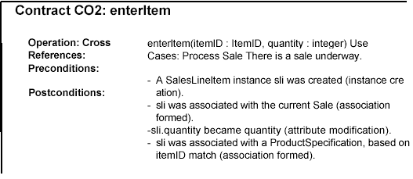
System on Contract

Slide 46
PREVIEW FOR LECTURE 7
BUILDING CONCEPTUAL/OBJECT MODEL
IDENTIFYING OBJECT
ADDING ASSOCIATIONS
ADDING ATTRIBUTES

